Slide 2
.NET Core 3.0
小朱
ex-MVP

Slide 3














Your platform for building anything
DESKTOP
WEB
CLOUD
MOBILE
GAMING
IoT
AI
.NET
Notes:
You can build anything with .NET.
We’ve made significant investments in .NET over the years as well as unifying the ecosystem to support building literally anything. From desktop to gaming to the cloud, .NET is a general purpose programming platform that enables all kinds of application scenarios. Once you learn one, you can easily pick up another.

Slide 4
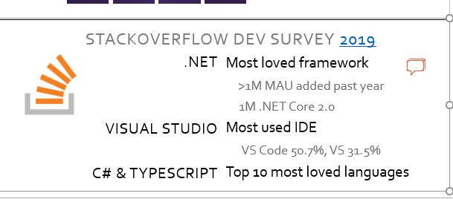
.NET Growth Continues
>1 million
>100
thousand
Fastest adopted version
.NET Core developers
Accepted community PRs
Visual Studio 2019
Notes:
And the platform keeps growing!
We’ve seen significant growth with .NET Core, our open source, cross-platform .NET, now has surpassed 1 million active developers per month.
And our open source repos are some of the most active on all of GitHub. We’ve accepted over 100 thousand pull requests from the community as we’ve built the platform together.
Of course, Visual Studio is our favorite IDE and we see Visual Studio 2019, released in April, has the fastest adoption for any version, EVER.
<CLICK>

Slide 5























Just a few of our millions of .NET customers… dot.net/customers
Notes:
Amazing developers like you have built incredible software with .NET for millions of companies around the world, in every industry. Here’s just a few. You can read their stories on our dot.net website.
<CLICK>
Customer notes (optional to call out here. Suggest keep it quick)
Setpoint Medical:
As a 35-person startup company, SetPoint Medical is a pioneer in bioelectronic medicine and has developed an implantable electronic therapy for treatment of chronic autoimmune diseases. This field has the potential to disrupt the pharma industry by eliminating drug treatments and side effects for these diseases. They build implantable medical devices used to treat the symptoms of a variety of autoimmune disorders, including Rheumatoid Arthritis, Chron’s Disease, and even Multiple Sclerosis.
They use WPF for their test infrastructure and applications. Moving to .NET Core 3.0 allowed them to take advantage of Windows 10 Bluetooth stack which dramatically simplified their application and helped them achieve regulatory compliance from the US government.
UPS: (everyone knows UPS)
UPS Mobile app—has improved customer experience and nearly halved the amount of code, compared with the previous platform-specific versions. Developers quickly brought the app to market using Visual Studio Tools for Xamarin.
Siemens Healthineers:
Siemens Healthineers is leading the digitalization of healthcare by helping health providers and solution developers bring more value to the delivery of care, ultimately improving the quality of insights derived from healthcare data. Siemens Healthineers uses Microsoft Azure to make solutions more accessible, and it uses Azure Kubernetes Service (AKS) and .NET Core for a fast, efficient, and competitive development pipeline.
Evolution Software:
Evolution Software Design, Inc. is a consulting firm that helps other organizations apply technology more effectively through strategic technology solutions and by developing healthcare, e-commerce, agriculture, and enterprise applications. One of the company's recent ventures is in the hazelnut industry, partnering with various hazelnut processing companies to improve the quality of hazelnuts from farm to consumer using machine learning and ML.NET. Evolution Software uses ML.NET to predict moisture levels of hazelnuts during the commercial drying process and alerts operators when they reach the ideal level.

Slide 6

RELEASED
.NET Core 3.0
WPF and Windows Forms support
Side-by-side support & self-contained EXEs
Full-stack web development with C# and Razor
New C# 8.0 language features
dot.net/get-core3
Notes:
But let’s get to why we’re here today. .NET Core 3.0 has released so go get it!
We’ve added Windows Desktop support with Windows Forms and WPF support. This brings the capabilities of .NET Core to these UI frameworks. Particularly, flexible deployment with side-by-side and self-contained EXEs so you don’t have to have .NET installed on the machine first anymore.
We also have some exiting new things for Web developers with Blazor, adding full-stack web development with C# and Razor, allowing you to build beautiful and responsive Single Page Apps without having to write JavaScript!
Additionally we have a ton of improvements for building better cloud native, scalable apps and services with ASP.NET as well as some exciting C# 8.0 language features.
<CLICK>

Slide 7
RELEASED
Visual Studio 2019 version 16.3 Visual Studio 2019 for Mac version 8.3
Support for .NET Core 3.0 and C# 8.0
New .NET productivity improvements
More performance improvements
iOS 13 & Android 10 support
visualstudio.com/downloads
Notes:
We’ve also just released some updates for Visual Studio 2019 version 16.3 and Visual Studio 2019 for Mac version 8.3!
Both add support for .NET Core 3.0 and C# 8.0, have many productivity and performance enhancements and have support for building iOS 13 & Android 10 mobile apps.
In particular, Visual Studio:
- Adds support for creating WPF and Windows Forms desktop applications with .NET Core 3.0, alongside ASP.NET Core web and Blazor applications, gRPC services, and much more.
- You can publish .NET Core 3.0 worker projects to Azure Container Registry, DockerHub, and elsewhere.
We also added for targeting .NET Framework 4.8 and F# 4.7.
Multiple productivity improvements were added for .NET developers, like more refactorings and search capabilities.
With Visual Studio 2019 for Mac:
We enhanced productivity with new C#, Web and XAML editors

Slide 8














SIM-SHIP PARTNERS
Partner Tools and Controls for .NET Core 3.0
Notes:
.NET has a rich ecosystem of partners building additional tools and controls to help you build beautiful, full-featured, applications faster.
We have many partners releasing support for .NET Core 3.0 in their tools and controls today as well.
THANK YOU!!
<CLICK>

Slide 9
Microservices
Notes:
Today we’re going to show you how .NET can be used to build any type of app. We’re going to start with cloud development and microservices.
<CLICK TO NEXT SLIDE>

Slide 10
Microservices: for faster app development
Monolithic
Microservices
Large, all-inclusive app
Small, independent services
Independent deployments
Improved scale and resource utilization per service
Smaller, focused teams
App
App
App
Notes:
Briefly explain the software trend to microservices for faster app development
With the move to the cloud over the last few years, the industry has embraced an architectural pattern for building cloud-scale, reliable services.
Microservices are Independent, immutable deployments within containers
Small scalable services for improved resource utilization
Teams can focus on their own service without affecting other, use their own tools/stack
.NET Core was built for the cloud and is well suited for this type of development

Slide 11
Azure Kubernetes Service (AKS)
Ship faster, operate easily, and scale confidently with managed Kubernetes on Azure
Manage Kubernetes with ease
Accelerate containerized development
Build on an enterprise-grade, secure foundation
Run anything, anywhere
Notes:
There are many orchestrators you can use to reliably run your microservices. Orchestrators make sure your services are communicating, scaling and performing well -- Kubernetes is one of the most popular. With Azure Kubernetes service you can manage Kubernetes easily.
You don’t need to worry about setting up secure communication of your services
AKS automatically takes care of monitoring, scaling and managing all your containers
<CLICK>

Slide 12
ASP.NET Core 3.0
gRPC
High performance contract-based RPC services with .NET
Works across many languages and platforms
Worker Service
Starting point for long running back processes like Windows Server or Linux daemon
Producing or consuming messages from a message queue
Web API’s + Identity
Add security and authentication to Web API’s
Notes:
We’ve added a ton of features to ASP.NET Core in version 3.0 on order to make building resilient microservices easier.

Slide 13
gRPC

Slide 14
C#
Notes:
Thanks Glenn!
Now let’s talk about C#.
<CLICK>

Slide 15
C# 8.0
Safe
Nullable and non-nullable reference types help you write safer code
Declare your intent more clearly
Modern
Async streams for modern workloads like cloud & IoT communication
Easily work with cloud scale datasets using indexes and ranges
Productive
Write less code using patterns
Protect data with readonly members
Improved using statements for resource management
Notes:
Most features of C# 8.0 capture a common action with new syntax, avoiding the bugs that come from having to write and maintain the longer version you would have had before.
C# 8.0 embraces modern development because the operations that get new syntax are ones with emerging importance in the modern developer landscape, like working with cloud scale datasets and asynchronous communication.
<CLICK>

Slide 16
Desktop Apps
Notes:
Thanks Mads!
Let’s shift to the client and talk about Windows desktop apps.
<CLICK>

Slide 17

Agenda
Why should you care about .NET Core for desktop
.NET Core or .NET Framework for my app
Porting to .NET Core
Fixing porting issues
Tolling for desktop on .NET Core
WinForms designer Preview 1

Slide 18
Why should you care about .NET Core for desktop

Slide 19
Why .NET Core for desktop
.NET Core is the future for .NET
.NET Core-specific features
Side-by-side deployment of different .NET Core versions
Self-contained applications
Single-file executables
Smaller app sizes
…and many more

Slide 20
How to choose: .NET Framework or .NET Core?
New apps
.NET Core
Completed apps in maintenance
OK to leave on .NET Framework
Existing apps in active development
Consider porting to .NET Core

Slide 21
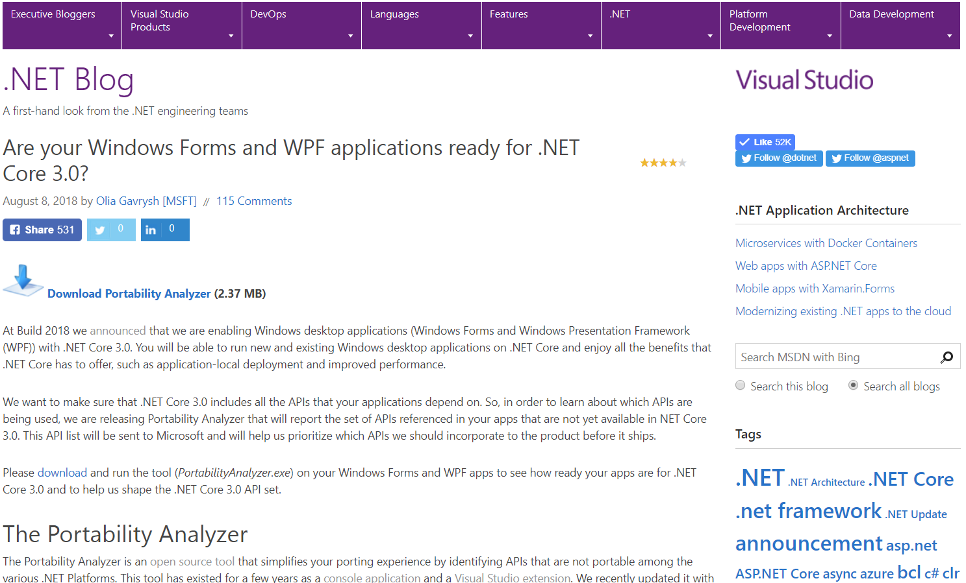
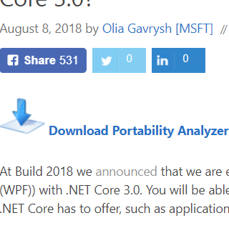
How compatible is my app with .NET Core?
Portability Analyzer
will show all APIs from your code that are not in .NET Core 3.0
https://aka.ms/portabilityAnalyzer

Slide 22
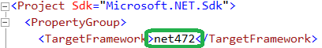
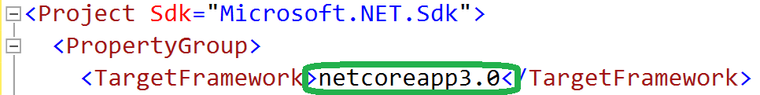
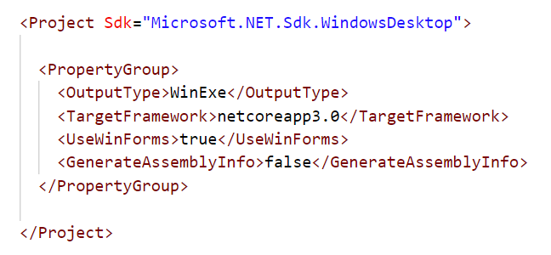
Porting
Porting to .NET Core\Standard is done by updating
If your .csproj file has old style, first migrate it to the new SDK-style

Slide 23
Porting by hand
If you have packages.config, right-click & “Migrate packages.config to PackageReference”
Update content of .csproj file with a .csproj file from blank .NET Core project
Add the references and resources from the old .csproj file:
<PackageReference>
<ProjectReference>
<Content>, <Resource>,…

Slide 24
Porting with Try Convert
Run from command line:
.\try-convert.exe -p “<path to your .csproj file>"

Slide 25
Windows Compatibility Pack
NuGet package Microsoft.Windows.Compatibility
Can be referenced from .NET Core & .NET Standard
Has ~21k APIs (Windows-only as well as cross-platform)
Contents
ACLs
Code Pages
CodeDom
Configuration
Crypto
DirectoryServices
EventLog
MEF
Odbc
Perf Counters
Permissions
…
Ports
Registry
Runtime Caching
WCF
Windows Services

Slide 26
WinForms Designer Preview 1
https://aka.ms/winforms-designer
Common controls and base operations
Further monthly previews
Too early to port if you use designer a lot
Give us your feedback via Visual Studio feedback channel

Slide 27
.NET Core 3.0 for Windows Desktop
Deployment Flexibility
Side-by-side deployment, self-contained EXEs
Install machine global or app local framework
Windows 10
Access modern Windows 10 APIs from WPF and WinForms
Use native Windows 10 controls via XAML islands
Open Source
WPF and WinForms projects also open source on GitHub
Take advantage of performance, runtime and API improvements happening in .NET Core
Notes:
We know we have millions of Windows developers using .NET. So .NET Core has added support for Windows Forms and WPF. This allows you to take advantage of the innovation happening in .NET Core, while still using the UI frameworks you know and love.

Slide 28
Web apps with Blazor

Slide 29







https://...
JS

Slide 30


Blazor
Build client-side web UI with .NET instead of JavaScript
Write reusable web UI components with C# and Razor
Share .NET code with both the client and the server
Call into JavaScript libraries & browser APIs as needed
C#

Slide 31

.NET

Slide 32

How Blazor WebAssembly works
https://...
Razor Components
DOM
.NET
WebAssembly

Slide 33
Blazor on client or server
Blazor WebAssembly
Blazor Server
https://...
https...
.NET Core
Razor Components
DOM
SignalR
DOM
.NET
WebAssembly
Razor Components
.NET
May 2020
.NET Core 3.0

Slide 34
Blazor on client or server
Blazor WebAssembly
Blazor Server
Pro:
True SPA, full interactivity
Utilize client resources
Supports offline, static sites, PWA scenarios
Con:
Larger download size
Requires WebAssembly
Still in preview
Pro:
Smaller download size, faster load time
Running on fully featured .NET runtime
Code never leaves the server
Simplified architecture
Con:
Latency
No offline support
Consumes more server resources
May 2020
.NET Core 3.0

Slide 35
Get started with Blazor
Go to https://blazor.net
Install .NET Core 3.0
Install the Blazor WebAssembly template
(Windows) Install Visual Studio 2019 16.3
(Mac/Linux) Install Visual Studio Code with the C# extension

Slide 36
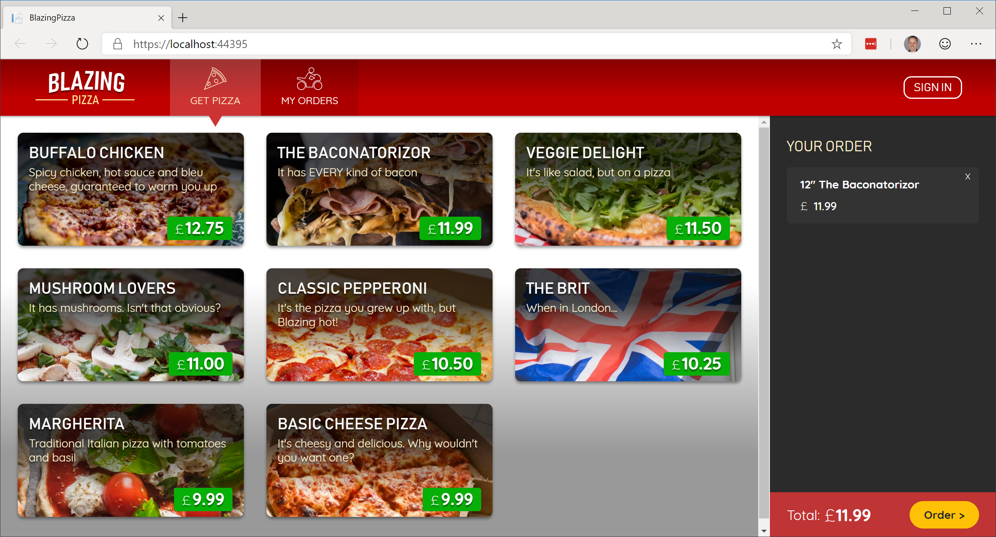
Build your own pizza store UI with Blazor
https://aka.ms/blazorworkshop

Slide 37


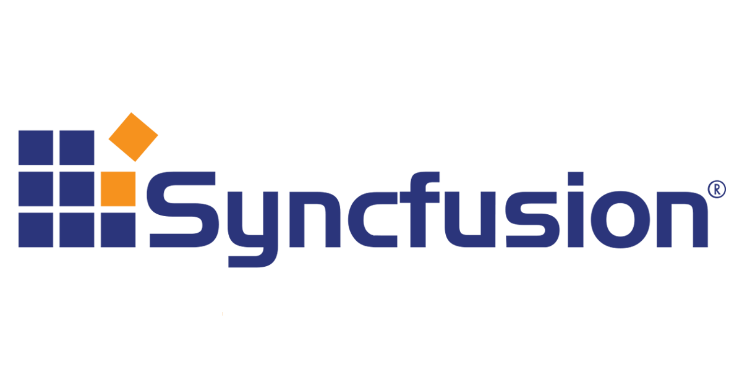
“Telerik UI for Blazor components have been built from the ground-up to ensure you experience shorter development cycles, quick iterations and cut time to market”
https://www.telerik.com/blazor-ui
“DevExpress UI for Blazor ships with 12 UI components (including a Data Grid, Pivot Grid, Charts and Scheduler) so you can design rich user experiences for both Blazor server-side and Blazor client-side platforms.”
https://www.devexpress.com/blazor
“The Syncfusion ASP.NET Core Blazor Components library is the only suite that you will ever need to build an application, containing over 60 high-performance, lightweight, modular, and responsive UI controls in a single package.”
https://www.syncfusion.com/blazor-components

Slide 38
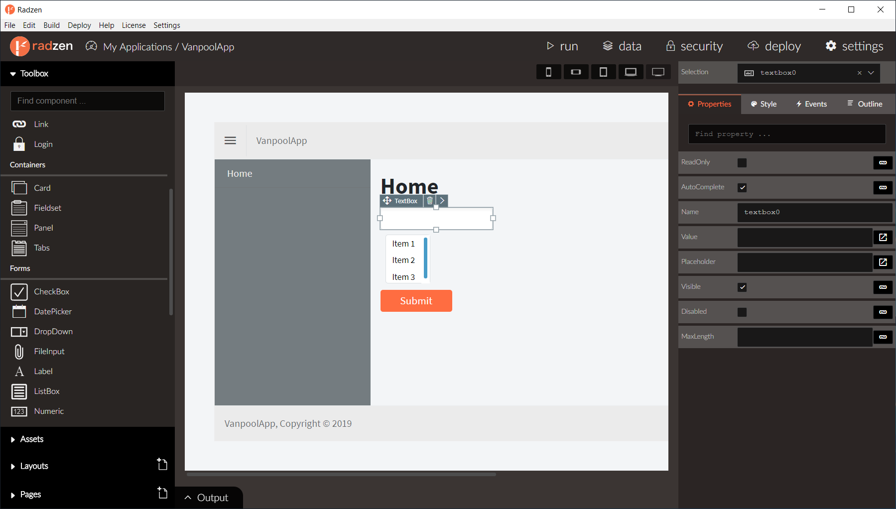
Radzen – Blazor WYSIWYG designer & UI components

Slide 39
The “Awesome Blazor” community
https://aka.ms/awesomeblazor
Free open-source components & JS interop libraries
Lots of fun sample Blazor apps
Articles, videos, blogs, and other learning materials
Chat with the Blazor community on Gitter: https://gitter.im/aspnet/blazor
Thank you, Simon and Chris!

Slide 40






So many platforms, so little time…
?

Slide 41
Web
Blazor Server
Web app
Every interaction handled on server
Prerendered HTML (optional)
Blazor WebAssembly
Web app with client-side execution
Loaded from web server
Can work offline via Service Worker
Desktop
+ Mobile

Slide 42
Blazor WebAssembly

Slide 43
Web
Blazor Server
Web app
Every interaction handled on server
Prerendered HTML (optional)
Blazor WebAssembly
Web app with client-side execution
Loaded from web server
Can work offline via Service Worker
Blazor PWA – OS installed
Appears as native app (own window)
Works offline or online
Desktop
+ Mobile

Slide 44
What is a PWA?
Progress Web App (PWA): A web app that users modern web standards to provide a closer-to-native user experience.
Works offline
Push notifications
Fast & responsive
OS installable

Slide 45
Blazor PWA

Slide 46
Web
Blazor Server
Web app
Every interaction handled on server
Prerendered HTML (optional)
Blazor WebAssembly
Web app with client-side execution
Loaded from web server
Can work offline via Service Worker
Blazor PWA – OS installed
Appears as native app (own window)
Works offline or online
Blazor Hybrid
Native .NET renders to Electron / WebView
Appears as native app (own window)
Works offline or online
Desktop
+ Mobile

Slide 47
Blazor Hybrid

Slide 48
Web
Blazor Server
Web app
Every interaction handled on server
Prerendered HTML (optional)
Blazor WebAssembly
Web app with client-side execution
Loaded from web server
Can work offline via Service Worker
Blazor PWA – OS installed
Appears as native app (own window)
Works offline or online
Blazor Hybrid
Native .NET renders to Electron / WebView
Appears as native app (own window)
Works offline or online
Desktop
+ Mobile
Blazor Native
Same programming model, but
rendering non-HTML UI

Slide 49
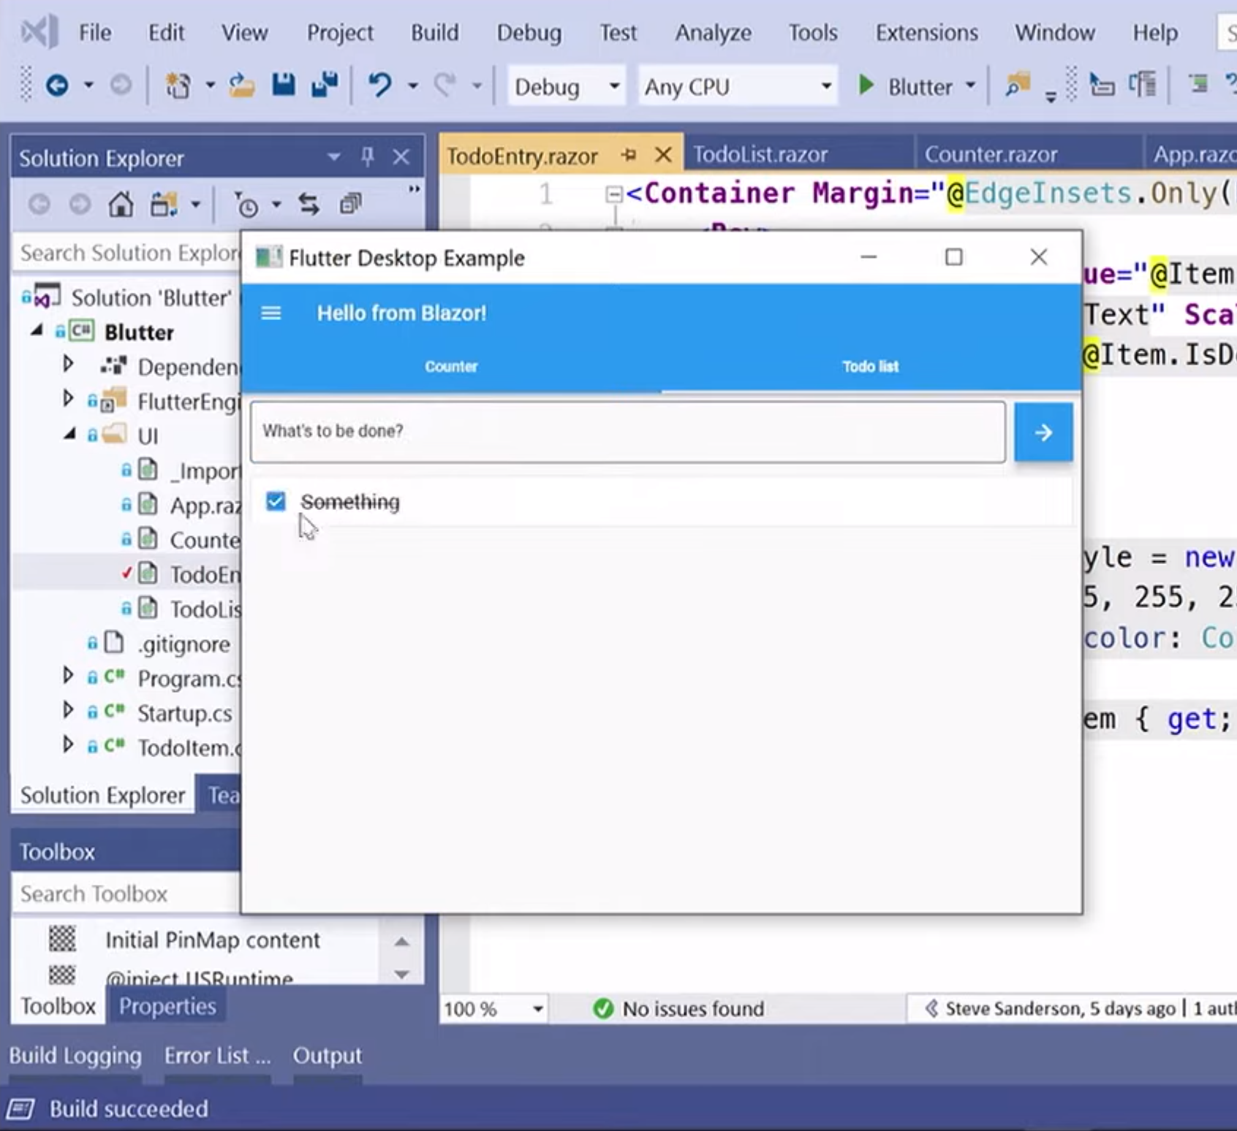
Blazor Native
By default, Blazor renders to HTML
But the rendering layer is replaceable
Possible to render to native controls instead
Currently exploring different options
https://aka.ms/blutter

Slide 50
Blazor roadmap
Blazor Server – Shipped with .NET Core 3.0!
Blazor WebAssembly – May 2020
Blazor PWA & Electron – Previews with .NET 5
Blazor Native – Under investigation

Slide 51
ASP.NET Core 3.0 Blazor
Full stack web development with C#
You don’t need to know AngularJS, React, Vue, etc.
Take advantage of stability and consistency of .NET
Runs in all browsers
Strongly typed on the client and server
Share C# code with the client and server
Web Assembly (In Preview, Release in May 2020)
Native performance
Requires no plugin or code transpilation
Notes:
Blazor is a new client-side web UI framework based on .NET and C# instead of JavaScript.
.NET has always had great support for building server-rendered web apps with ASP.NET, where your .NET code runs on the server and generates HTML & JSON responses. But if you ever wanted to add some client-side functionality to your web app that runs in the browser on the user's device, that meant you had to write some JavaScript.
Well, not anymore! Blazor enables full-stack web development with .NET using only open web standards. .NET Core 3.0 ships support for Blazor Server apps, which enables you to handle client-side UI interactions over a real-time SignalR connection. And in the near future with Blazor WebAssembly you'll be able to run your .NET code directly in the browser on WebAssembly-based .NET runtime.

Slide 52
Summary
Blazor Server now available with .NET Core 3.0
Build full-stack web apps with C# and .NET
Rich component model and UI framework
Integrates with existing ASP.NET Core apps
Blazor WebAssembly coming in May 2020

Slide 53
EF Core 3.0

Slide 54
What’s new in EF Core 3.0
LINQ overhaul
New architecture
Constrained client evaluation
Single SQL query per LINQ query
C# 8 support
Async streams
Nullable reference types
Cosmos DB provider
Database interception
Reverse engineering of views
Microsoft.Data.SqlClient

Slide 55
EF 6.3 on .NET Core
Happy with EF 6 features and performance, but need to move to .NET Core?
No new features (but some community PRs)
No SQL Server spatial on .NET Core
No EF designer support yet
Providers will need to port to .NET Core

Slide 56
What’s next?
EF Core 3.1
Long Term Support release
Bug fixes and small enhancements
EF Core “vNext” (under discussion)
Performance improvements
Many-to-many
Table-per-type inheritance
Stored procedure support
Update model from database
Primitive types from raw SQL
Property bag entities
Ignore parts of the model for migrations

Slide 57
.NET 5

Slide 58
.NET 5
.NET
.NET FRAMEWORK
.NET CORE
.NET
XAMARIN / MONO
Runtime (JIT & Native)
Runtime
Runtime
Runtime
One Base Class Library
Base Class Library
Core Library
Mono Class Library
.NET STANDARD
Notes:
2019 – Introduce .NET 5 – Windows, Mac, Linux, Android, IOS all run .NET Core’s runtime
Same BCL used on all platforms, same runtime used on all platforms
Native code compilation on all platforms, by merging .NET Native and Mono AOT
JIT and AOT Runtime
.NET 5 is the next major version of the .NET Platform that brings technologies from .NET Framework, .NET Core and & Mono runtimes and frameworks together into one .NET platform.
.NET 5 will have one Base Class Library (BCL) that will contain APIs for building any type of application. All .NET workloads are supported with application frameworks including cross-platform web development with ASP.NET, iOS and Android mobile development with Xamarin, Windows Desktop, and cross-platform IoT.
.NET 5 will have both Just-in-Time (JIT) and Ahead-of-Time (AOT) compilation models for the multiple compute and device scenarios it must support. JIT has better performance for server and desktop workloads as well as development environments. AOT has better startup, a small footprint, and is required for mobile and IoT devices.
.NET 5 will also have one unified toolchain supported by new SDK project types, will have a flexible deployment model (Side-by-Side and self-contained EXEs) and continue .NET Core's superior performance for server & cloud workloads.

Slide 59
.NET Schedule
July 2019
.NET Core 3.0
RC
Sept 2019
.NET Core 3.0
Nov 2019
.NET Core 3.1
LTS
Nov 2020
.NET 5.0
Nov 2021
.NET 6.0
LTS
Nov 2022
.NET 7.0
Nov 2023
.NET 8.0
LTS
.NET Core 3.0 released today!
.NET Core 3.1 = Long Term Support (LTS)
.NET 5.0 release in November 2020
Major releases every year, LTS for even numbered releases
Predictable schedule, minor releases if needed

Slide 60




.NET – A unified platform
TOOLS
DESKTOP
WEB
CLOUD
MOBILE
GAMING
IoT
AI
WPF
Windows Forms
UWP
ASP.NET
Azure
Xamarin
Unity
ARM32
ARM64
ML.NET
.NET for Apache Spark
VISUAL STUDIO
.NET STANDARD
VISUAL STUDIO FOR MAC
.NET 5
VISUAL STUDIO CODE
INFRASTRUCTURE
RUNTIME COMPONENTS
COMPILERS
LANGUAGES
COMMAND LINE INTERFACE

Slide 61
Download .NET Core 3.0 Today!
dot.net/get-core3
visualstudio.com/downloads
DESKTOP
WEB
CLOUD
MOBILE
GAMING
IoT
AI
.NET

